Slide 1

Special Topics 1 CIS 306
John P. Baugh, Ph.D.

Slide 2
What will we study?
We will discuss fundamental set theory, which should be a review
The Set is in fact a data structure, so discrete mathematics intersects obviously with data structures studies
We will also discuss the fundamentals of logical connectives and expressions
These help us to think through propositional logic to begin with
The foundation of logic is in propositional logic, which can help us understand more complex and different kinds of logic later on
E.g., predicate logic (first order logic)

Slide 3

Basic Set Theory

Slide 4
Sets
A set is a collection of elements
There are many popular sets, usually designated as follows:
N = natural numbers {0, 1, 2, 3, …}
Z = set of integers {… -2, -1, 0, 1, 2, …}
Q = rational numbers
R = real numbers
Also, notation like Z⁺ indicates all positive integers

Slide 5
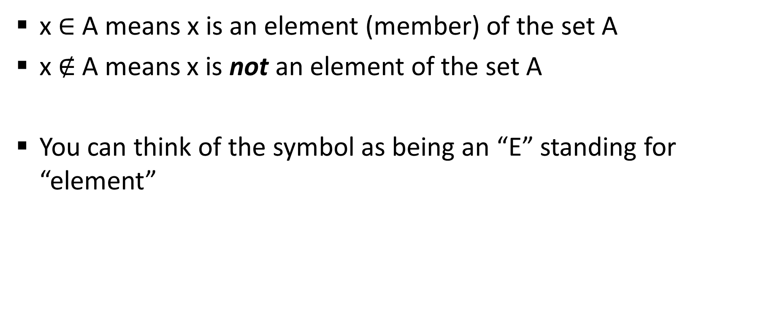
Membership of Sets
x $∈$ A means x is an element (member) of the set A
x $∉$A means x is not an element of the set A
You can think of the symbol as being an “E” standing for “element”

Slide 6

Example: Membership of Sets
Assume S = {1, 3, 6, 8, 9}
Then,
1 $∈$ S
4 $∉$ S

Slide 7
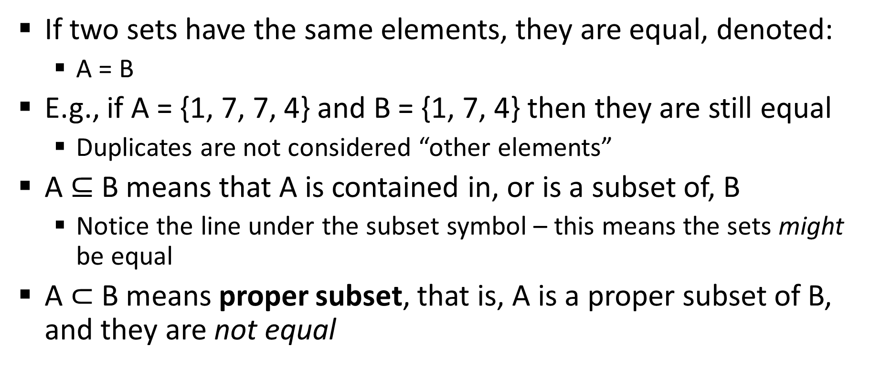
Set Equality and Containment
If two sets have the same elements, they are equal, denoted:
A = B
E.g., if A = {1, 7, 7, 4} and B = {1, 7, 4} then they are still equal
Duplicates are not considered “other elements”
A $⊆$ B means that A is contained in, or is a subset of, B
Notice the line under the subset symbol – this means the sets might be equal
A $⊂$ B means proper subset, that is, A is a proper subset of B, and they are not equal

Slide 8

Example: Subsets
Set A = {4, 9, 10, 6, 12}
Set B = {4, 6, 2, 7, 1}
Set C = {4, 2, 1}
So:
C $⊂$ B
A $⊄$ B
C$⊄$A

Slide 9
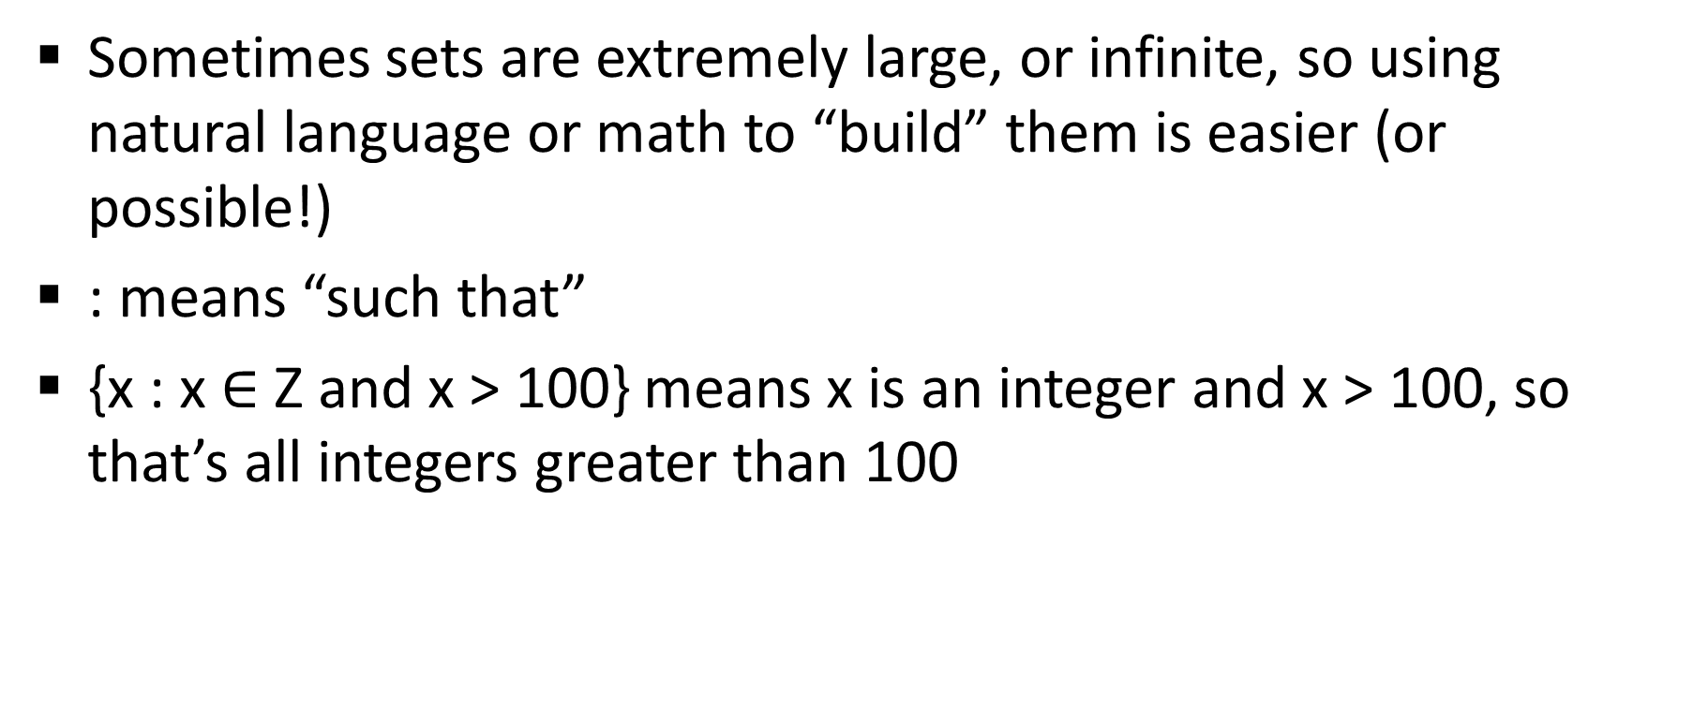
Set Builder Notation
Sometimes sets are extremely large, or infinite, so using natural language or math to “build” them is easier (or possible!)
: means “such that”
{x : x $∈$ Z and x > 100} means x is an integer and x > 100, so that’s all integers greater than 100

Slide 10
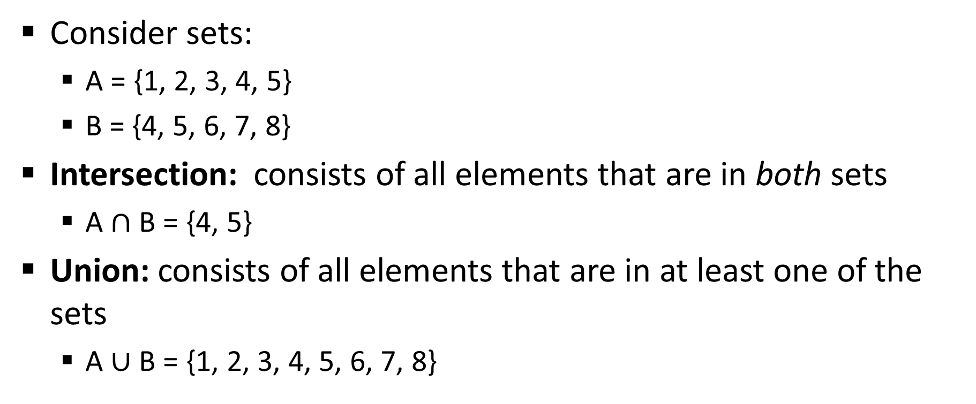
Set Operations
Consider sets:
A = {1, 2, 3, 4, 5}
B = {4, 5, 6, 7, 8}
Intersection: consists of all elements that are in both sets
A $∩$ B = {4, 5}
Union: consists of all elements that are in at least one of the sets
A $∪$ B = {1, 2, 3, 4, 5, 6, 7, 8}

Slide 11
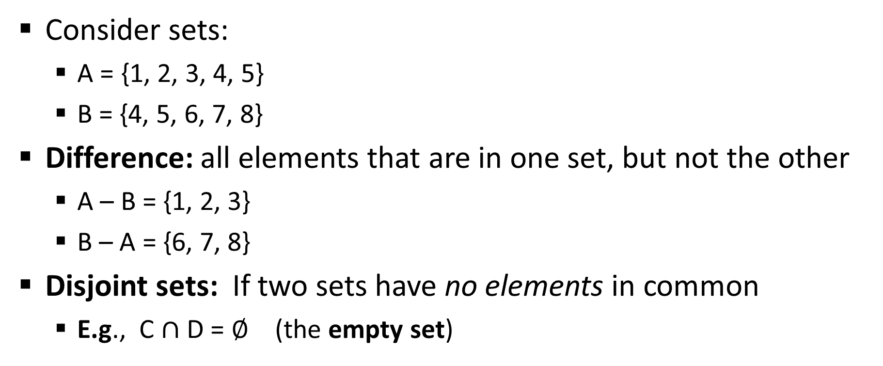
Set Operations
Consider sets:
A = {1, 2, 3, 4, 5}
B = {4, 5, 6, 7, 8}
Difference: all elements that are in one set, but not the other
A – B = {1, 2, 3}
B – A = {6, 7, 8}
Disjoint sets: If two sets have no elements in common
E.g., C $∩$ D = $∅$ (the empty set)

Slide 12
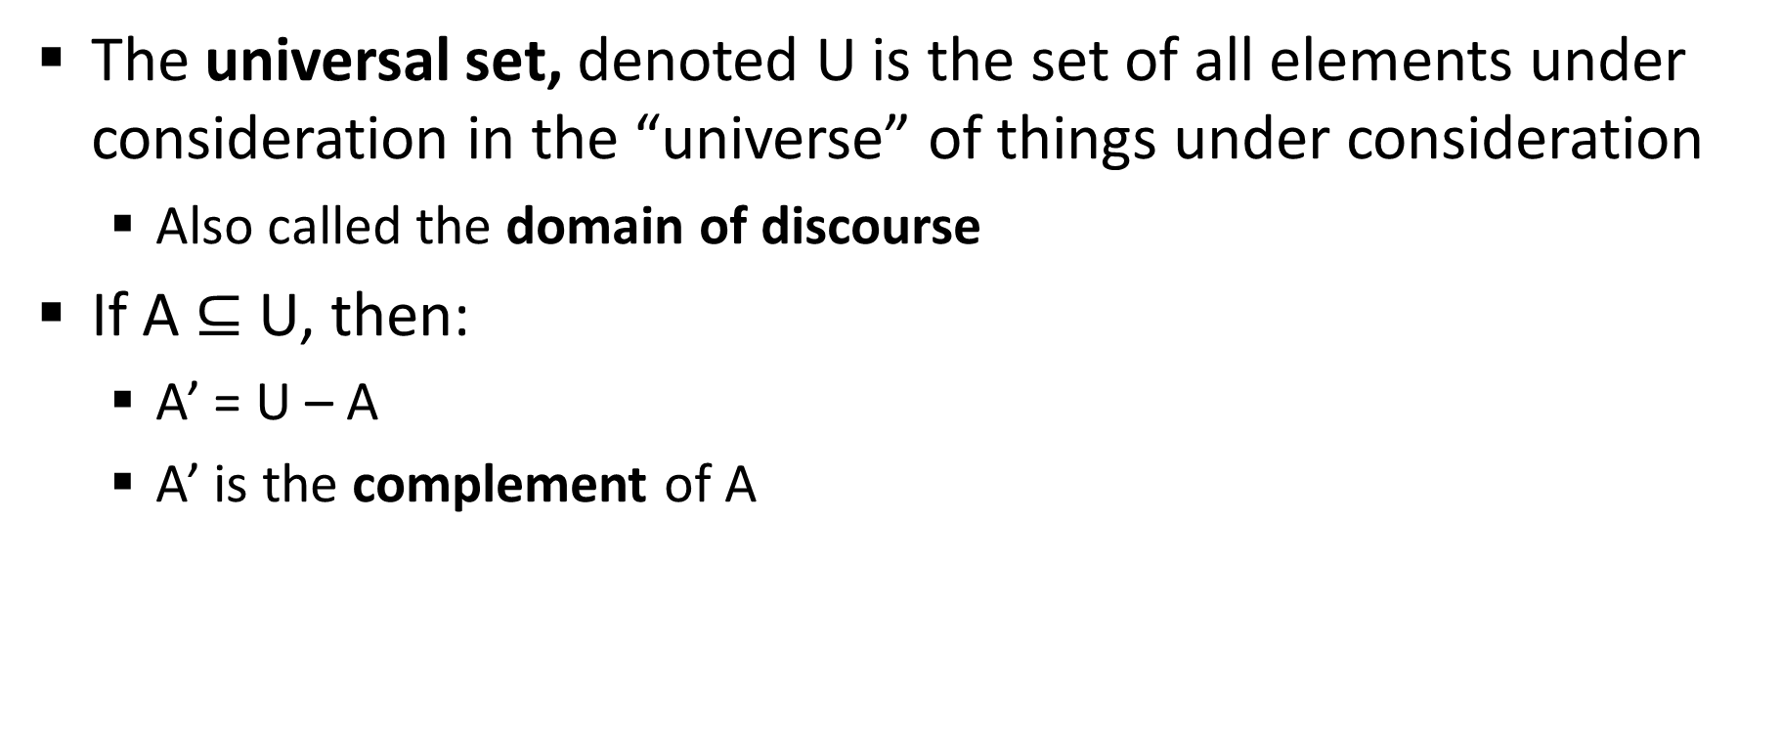
Universal Sets and Complements
The universal set, denoted U is the set of all elements under consideration in the “universe” of things under consideration
Also called the domain of discourse
If A $⊆$ U, then:
A’ = U – A
A’ is the complement of A

Slide 13
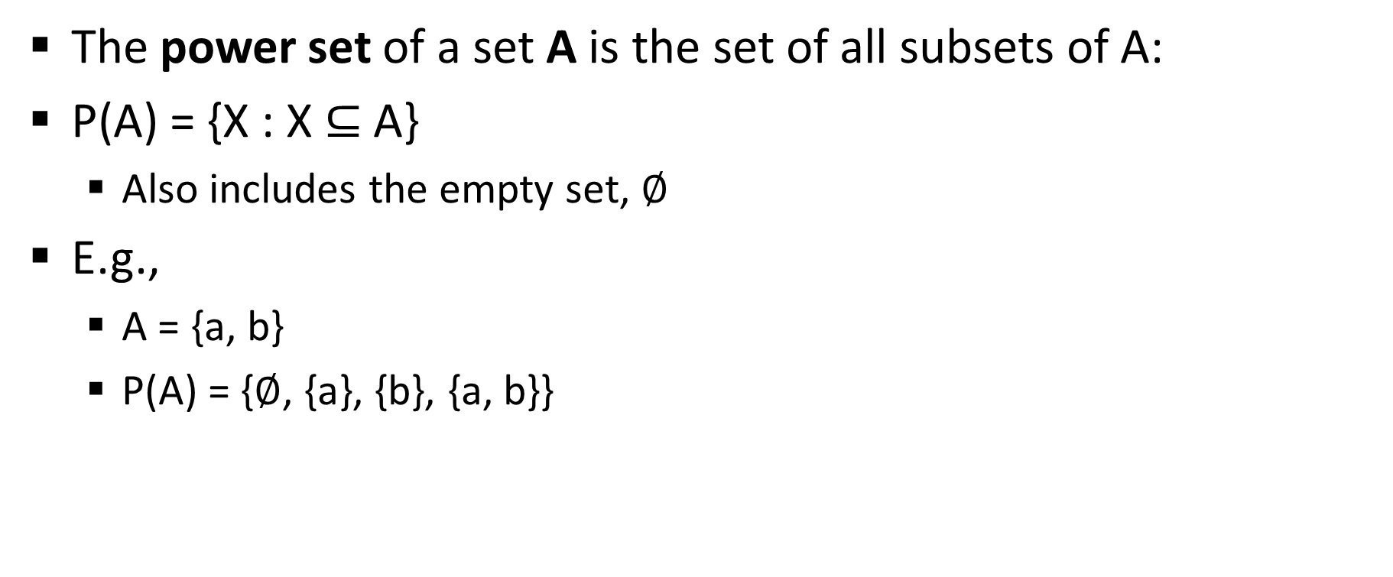
Power Sets
The power set of a set A is the set of all subsets of A:
P(A) = {X : X $⊆$A}
Also includes the empty set, $∅$
E.g.,
A = {a, b}
P(A) = {$∅$, {a}, {b}, {a, b}}

Slide 14
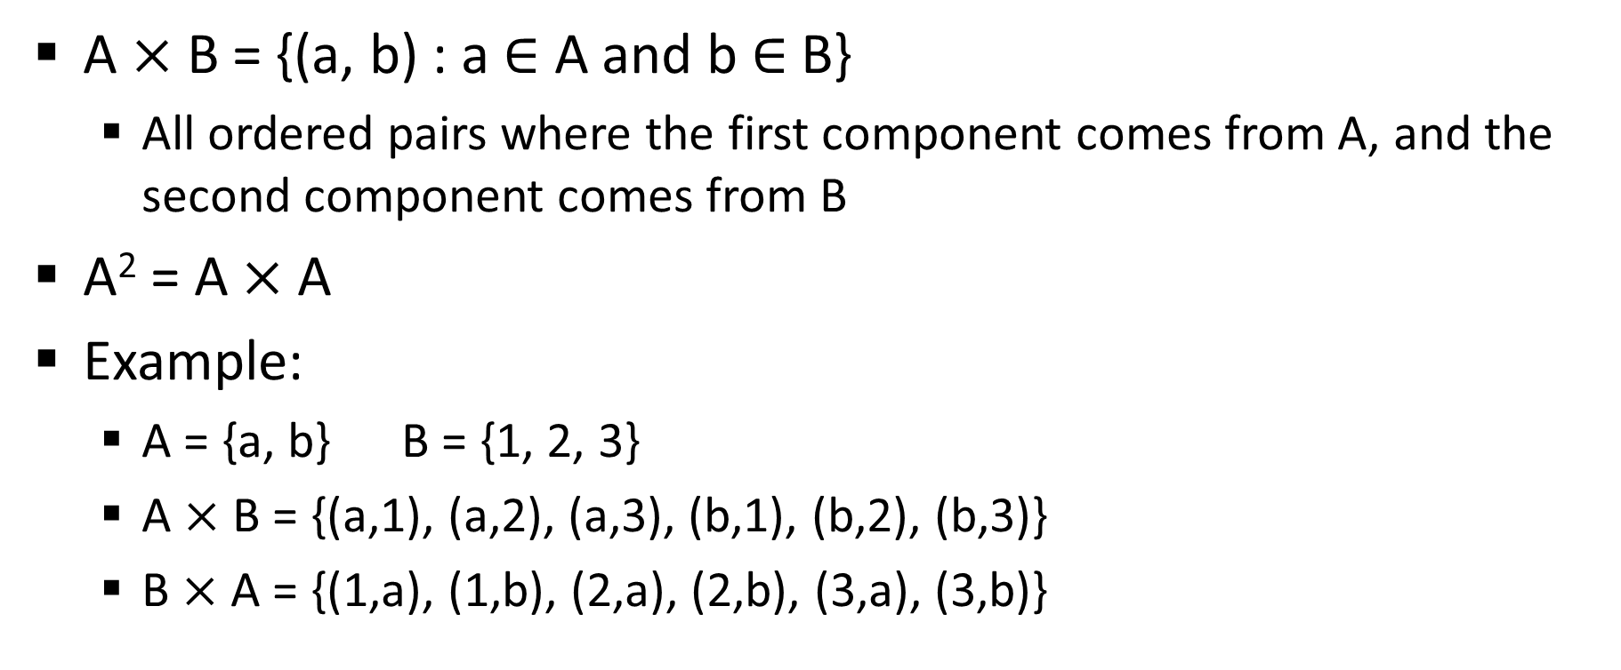
Cartesian Products
A $×$ B = {(a, b) : a $∈$ A and b$∈$ B}
All ordered pairs where the first component comes from A, and the second component comes from B
A² = A $×$ A
Example:
A = {a, b} B = {1, 2, 3}
A $×$ B = {(a,1), (a,2), (a,3), (b,1), (b,2), (b,3)}
B $×$ A = {(1,a), (1,b), (2,a), (2,b), (3,a), (3,b)}

Slide 15
Relations and Functions

Slide 16
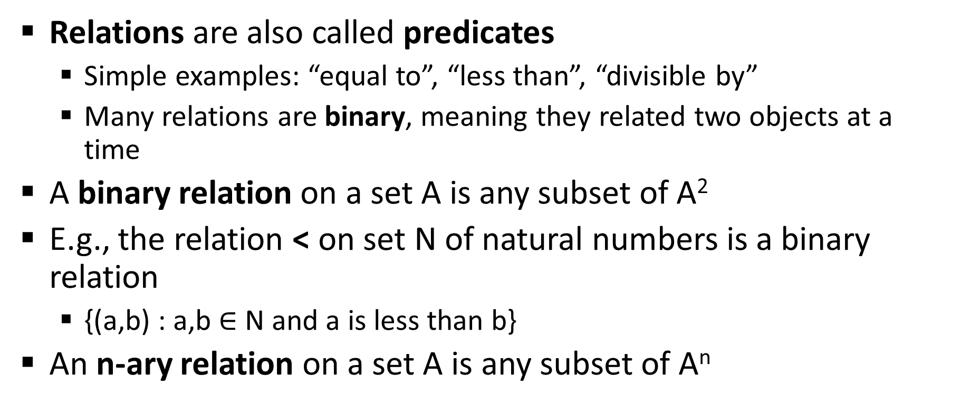
Relations
Relations are also called predicates
Simple examples: “equal to”, “less than”, “divisible by”
Many relations are binary, meaning they related two objects at a time
A binary relation on a set A is any subset of A²
E.g., the relation < on set N of natural numbers is a binary relation
{(a,b) : a,b $∈$ N and a is less than b}
An n-ary relation on a set A is any subset of A^{n}

Slide 17
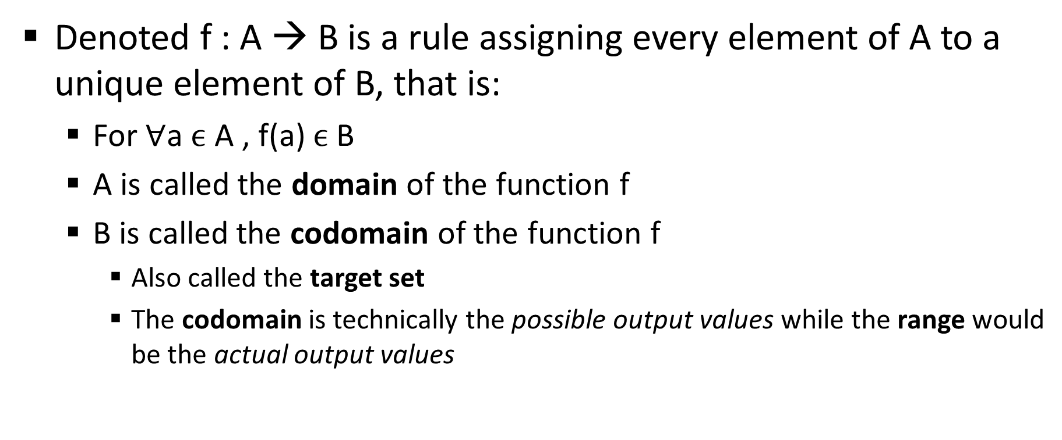
Functions
Denoted f : A → B is a rule assigning every element of A to a unique element of B, that is:
For $∀$a $ϵ$ A , f(a) $ϵ$ B
A is called the domain of the function f
B is called the codomain of the function f
Also called the target set
The codomain is technically the possible output values while the range would be the actual output values

Slide 18
Fundamental Logic Connectives and Expressions

Slide 19
Propositions
The fundamental concept of propositional logic is the proposition
A proposition is a sentence that can be assigned a truth value, that is, true or false
E.g.,
The Sun is hot
2 plus 5 equals 99
The second decimal of pi is 4

Slide 20
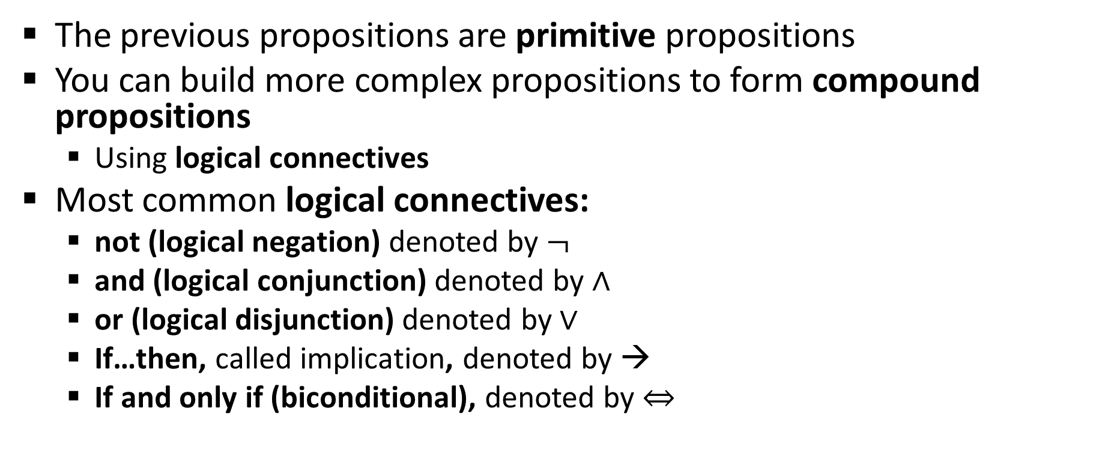
Propositional logical connectives
The previous propositions are primitive propositions
You can build more complex propositions to form compound propositions
Using logical connectives
Most common logical connectives:
not (logical negation) denoted by $¬$
and (logical conjunction) denoted by $∧$
or (logical disjunction) denoted by $∨$
If…then, called implication, denoted by →
If and only if (biconditional), denoted by $⇔$

Slide 21
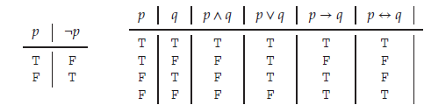
Truth Tables

Slide 22
Computing Truth Values of Propositions
“It is not the case that three plus three equals seven” is true
“One plus one equals five and the Sun is hot” is false
“One plus one equals five or the Sun is hot” is true
“If two plus two equals five, then the Sun is hot” is true
Even though it does not actually make sense, as these are not related
It’s in the form F → T, so F → T = T

Slide 23

Quantifiers
The quantifier “for every”, is called the universal quantifier, denoted by $∀$
The quantifier “there exists” is called the existential quantifier, denoted by $∃$

Slide 24
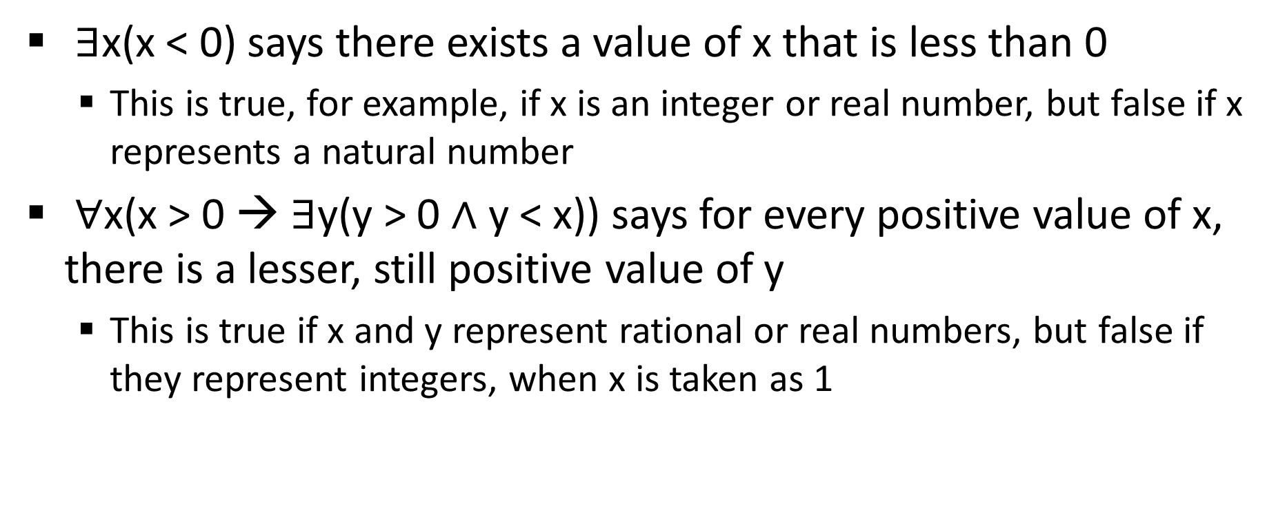
Mathematical formulae with quantification
$∃$x(x < 0) says there exists a value of x that is less than 0
This is true, for example, if x is an integer or real number, but false if x represents a natural number
$∀$x(x > 0 → $∃$y(y > 0 $∧$ y < x)) says for every positive value of x, there is a lesser, still positive value of y
This is true if x and y represent rational or real numbers, but false if they represent integers, when x is taken as 1

Slide 25
Questions, comments?
Send an e-mail if you’re having trouble

